Slide 1
Understanding and Monitoring Embedded Web Scripts
Yuchen Zhou, David Evans, University of Virginia
PRESENT BY ZEYI TAO

Slide 2
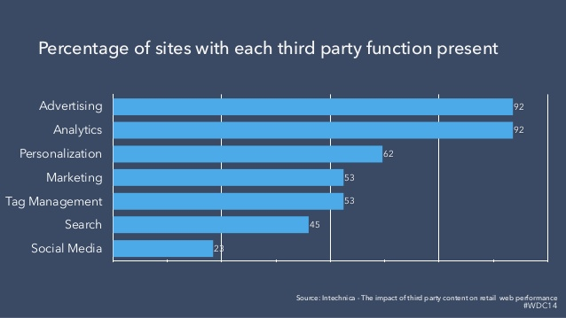
Introduction

Slide 3
Example: New York Times Website

Slide 4
Related Work
Client-side script protections.
Script transformations.
Policy generation.

Slide 5
Motivation
Introduces tools to assist site administrators in understanding, monitoring, and restricting the behavior of third-party scripts embedded in their site.

Slide 6
OVERVIEW
Introduction & Pervious Works
Motivation
Design
Policing
Inspecting Script Behavior
Visualizing
More Design Details
Developing Base Polices
Developing Site-Specific Polices
Police Evaluations
Conclusions & Quizzes

Slide 7
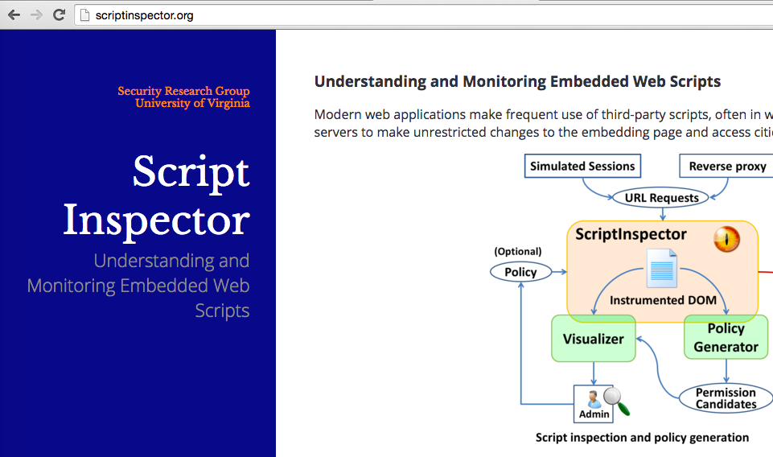
BASIC DESIGN

Slide 8
BASIC DESIGN

Slide 9
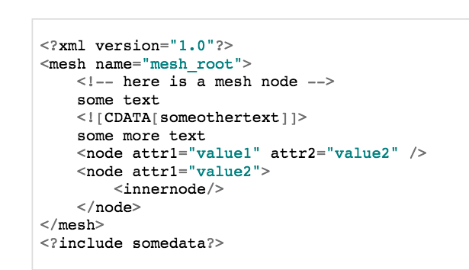
Document Object Model(DOM)

Slide 10
POLICIES

Slide 11
Node Descriptor
AbsoluteXPath: /HTML[1]/BODY[1]/DIV[1]/
SelectorXPath: // DIV[@class=‘ad’]
Regular Expression Xpath //DIV[@ID=‘adSize−\d∗x\d∗’]
^NodeSelector ˆˆ// DIV[@ID=‘adPos’]
// DIV[@ID=‘adPos’]/DIV[2]

Slide 12
INSPECTING SCRIPT BEHAVIOR
Recording accesses
DOM access recording
Recording other actions
Script-injected nodes
Attribution
Checking policies

Slide 13
VISUALIZATION

Slide 14
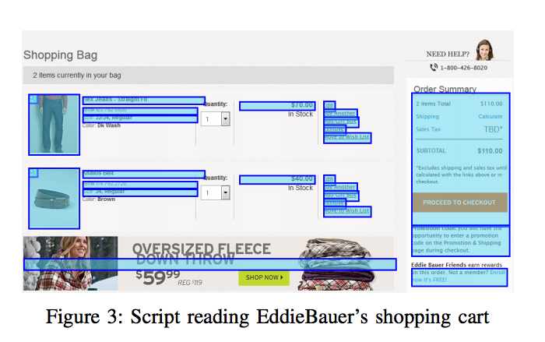
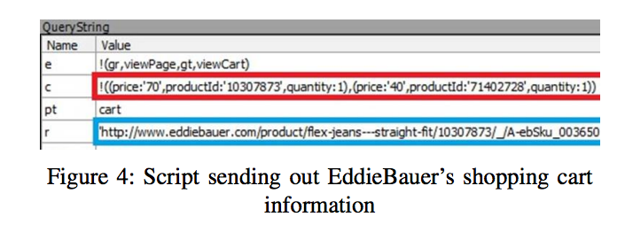
FINDINGS
Browser properties
Network
Modifying page content
Reading page content

Slide 15
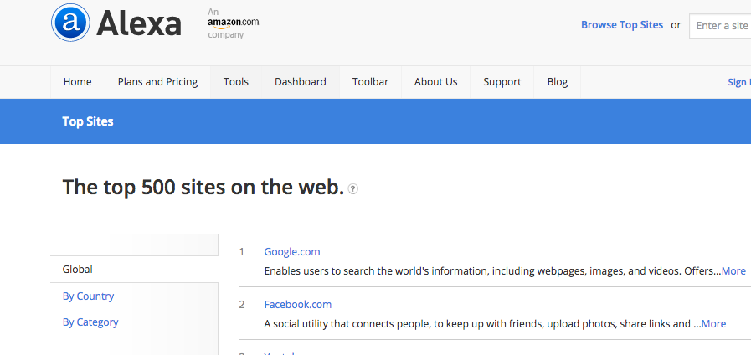
DEVELOPING BASE POLICIES
Evaluation method
25 selected scripts, 1000 highest ranked websites
Base policy examples
Analytics scripts
Advertisements
Social widgets
Web development

Slide 16
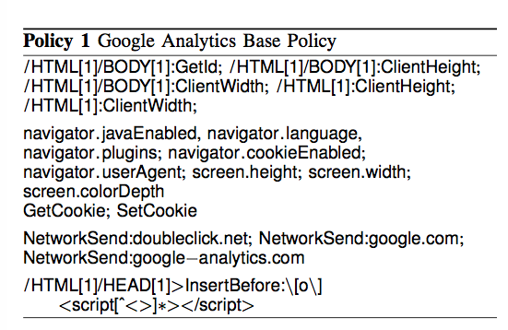
Analytics scripts

Slide 17
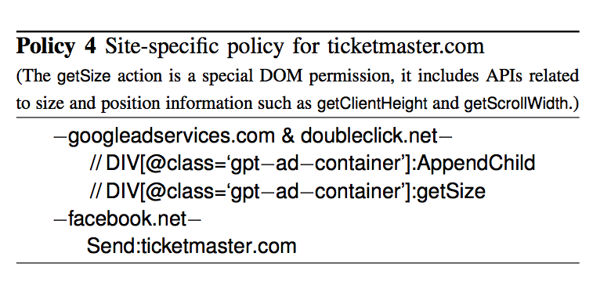
DEVELOPING SITE-SPECIFIC POLICIES
PolicyGenerator
Site-specific policy examples

Slide 18
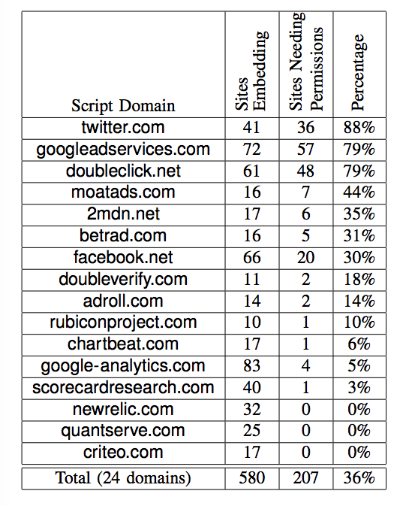
POLICY EVALUATION
Policy size

Slide 19
POLICY EVALUATION
Policy robustness

Slide 20
Conclusion
ScriptInspector
Capable of intercepting and recording API calls from third-party scripts to critical resources, including the DOM, local storage, and network
Visualizer
Firefox extension that uses the instrumented DOM maintained by ScriptInspector to highlight nodes accessed by third-party scripts and help a site administrator understand script behaviors.
PolicyGenerator
PolicyGenerator to help site administrators develop effective policies with limited human intervention
Threat model
Provide site administrators with a way to ensure the integrity of their site and protect the privacy of their users from embedded scripts

Slide 21
Quizzes
What is the DOM?
What are the 4 major Script groups based on this paper
What is the limitation of this system?

